Slide 1
Heat transfers, Lecture 3, still Lesson 4: Introduction to the first law of thermodynamics
Teacher: Paul Briard
Wechat: Paulbg123

Slide 2
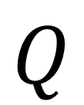
So, what is the heat ?
Symbol of the heat :
$$Q$$
Unit of the heat : Joules (symbol: J)

Slide 3
Warning about the heat
You know different kinds of energy: kinetic energy, potential energy, internal energy and so on…
Heat is not a kind of energy
Heat is a kind of transfer of energy between two systems

Slide 4
Another kind of energy transfer: The work
As for the heat, the definition of “work” in Physics in not the common definition.
Work is a kind of transfer of energy between two systems (or a transfer from one kind of energy to another kind for instance by the work done by the gravitational force on an object in free fall, potential energy become kinetic energy).
Work is a mechanical transfer of energy

Slide 5
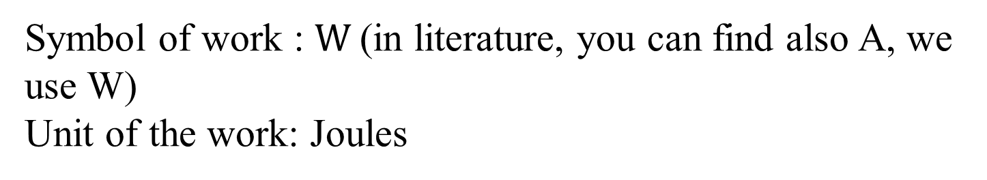
Example of transfer of energy by work
The gas in a piston of heat engine transfer energy by work to its surrounding, due to the motion of the piston (which permits to move)
Symbol of work : $W$(in literature, you can find also A, we use W)
Unit of the work: Joules

Slide 6

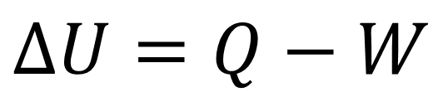
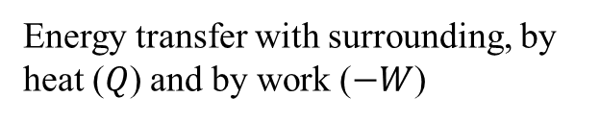
The first law of thermodynamics
“The change of internal energy of a thermodynamic system corresponds to the transfer of energy between the system and its surrounding”
Although it seems trivial, this law is very important, because it permits to describe the behaviour of the system if we can describe the transfer of energy.
Mathematical form of the first law of thermodynamics:
$$∆U=Q−W$$
Important to remember
Change of internal energy:
Energy transfer with surrounding, by heat ($Q$) and by work ($−W$)
$$∆U=U_{f}−U_{i}$$

Slide 7
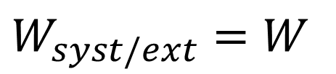
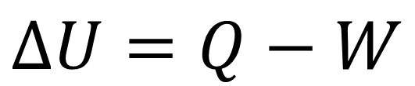


The first law of thermodynamics
$$∆U=Q−W$$
The choice of the sign is a convention (sign + could be chosen) and depends to which work you consider (done by the system on its surrounding or done by the surrounding on the system). But please to keep sign – to avoid confusion
So the work done by the surroundings to the system is:
$W_{ext/syst}=−W$
$$∆U=Q+W_{ext/syst}$$
The work done by the system to its surrounding is:
$W_{syst/ext}=W$
“ext” means external, i.e. the surrounding of the system

Slide 8
The first law of thermodynamics
$$∆U=Q−W$$
With this sign convention,
$W>0$: The system do a positive work to its surroundings
$W<0$: The system do a negative work to its surroundings

Slide 9
The first law of thermodynamics
$$∆U=Q−W$$
About the heat flow:
$Q>0$: Heat flows from the surroundings toward the system.
$Q<0$: Heat flows from the system toward the surroundings
The “direction” of heat flow is meaningful, you can think about your hand as a system on a hot radiator, for instance.

Slide 10
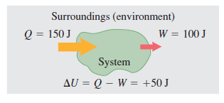
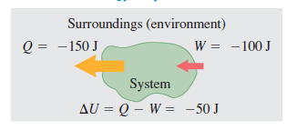
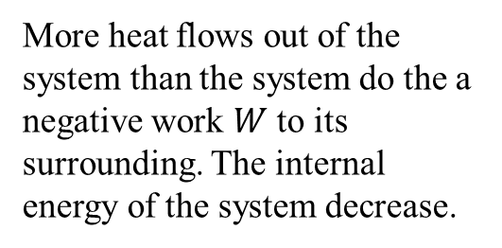
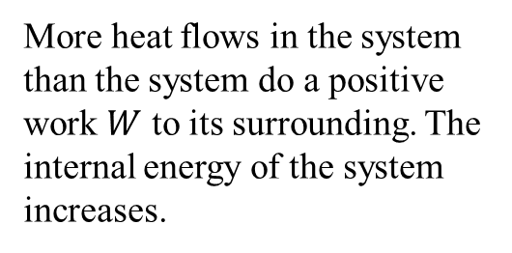
The first law of thermodynamics
$$∆U=Q−W$$
Some examples:
More heat flows in the system than the system do a positive work $W$ to its surrounding. The internal energy of the system increases.
More heat flows out of the system than the system do the a negative work $W$ to its surrounding. The internal energy of the system decrease.

Slide 11
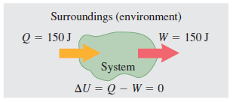



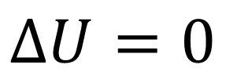

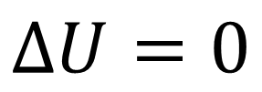
The first law of thermodynamics
Particular cases:
If there is no energy transfer by work and by heat, then:
$$Q=0$$
$$∆U=0$$
$$W=0$$
The internal energy don’t change
If the heat which flows toward the system is equal to the work done by the system on its surrounding, then:
$$Q=W$$
$$∆U=0$$
$$Q−W=0$$
The internal energy don’t change

Slide 12
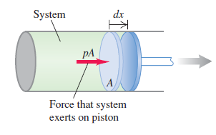

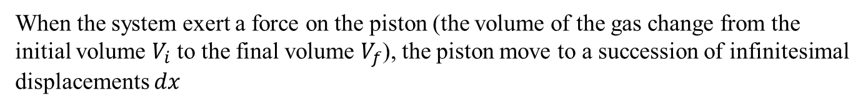


Work done by a gas on a piston
Initial volume $V_{i}$
When the system exert a force on the piston (the volume of the gas change from the initial volume $V_{i}$ to the final volume $V_{f}$), the piston move to a succession of infinitesimal displacements $dx$
The force exerted by a gas at pressure $p$ on the piston of area $A$ is:
$$F=pA$$
The infinitesimal work done by the gas to the piston during the displacement $dx$ is:
$$dW=Fdx=pAdx$$

Slide 13

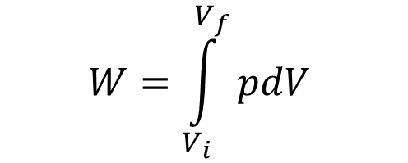


Work done by a gas on a piston
The infinitesimal work done by the gas to the piston is:
$$dW=pAdx$$
The quantity $Adx$corresponds to the infinitesimal change $dV$ of the volume of the system
$$dV=Adx$$
$$dW=pdV$$
Important to remember
$$W=\int_{V_{i}}^{V_{f}}{pdV }$$
By integration, we obtain the work done by the gas to the piston :

Slide 14

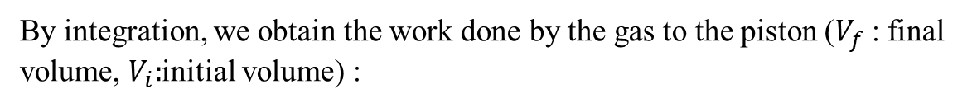
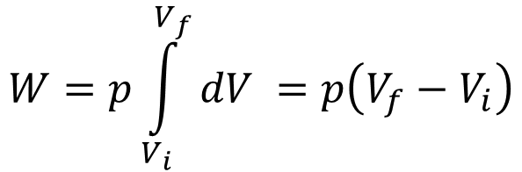
Work done by a gas on a piston
By integration, we obtain the work done by the gas to the piston ($V_{f}$ : final volume, $V_{i}:$initial volume) :
$$W=\int_{V_{i}}^{V_{f}}{pdV }$$
Important to remember
Take care that the pressure depends on the volume (see the ideal gas law).
However, in particular conditions, the pressure can be controlled and be considered constant. In this situation, we obtain the work done by the system on the piston:
$$W=p\int_{V_{i}}^{V_{f}}{dV }=p\left(V_{f}−V_{i}\right)$$
Work done by the system on its surroundings at constant pressure (isobaric process/or transformation)
(important to remember)

Slide 15

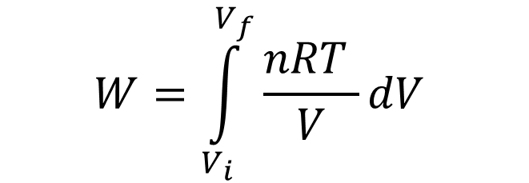
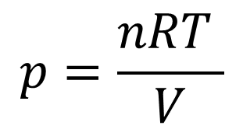

Work done by an ideal gas on a piston
By integration, we obtain the work done by the gas to the piston ($V_{f}$ : final volume, $V_{i}:$initial volume) :
$$W=\int_{V_{i}}^{V_{f}}{pdV }$$
Case of an ideal gas:
$$p=\frac{nRT }{V}$$
$$pV=nRT$$
$$W=\int_{V_{i}}^{V_{f}}{\frac{nRT }{V}dV }$$
Work done by an ideal gas on a piston
Take care that the temperature could change during the process (we cannot put it outside the integral, excepted particular case).

Slide 16
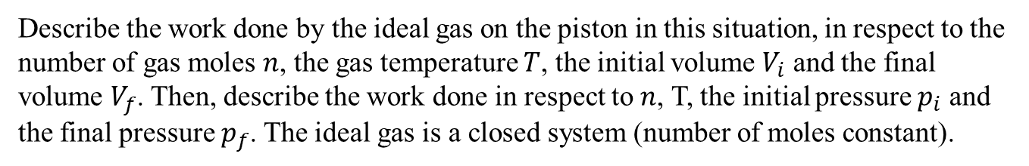
Ex: Work done on a piston by an ideal gas in isothermal expansion (5 minutes)
We consider a case of isothermal expansion of a gas which move a piston (temperature $T$ is constant). The number of moles $n$ of gas is also constant.
Describe the work done by the ideal gas on the piston in this situation, in respect to the number of gas moles $n$, the gas temperature $T$, the initial volume $V_{i}$ and the final volume $V_{f}$. Then, describe the work done in respect to$n$, T, the initial pressure $p_{i}$ and the final pressure $p_{f}$. The ideal gas is a closed system (number of moles constant).

Slide 17

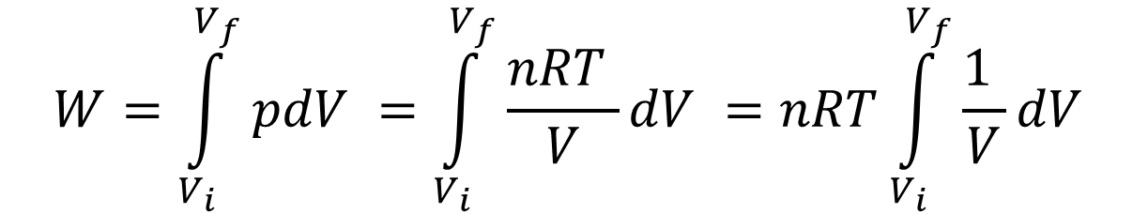

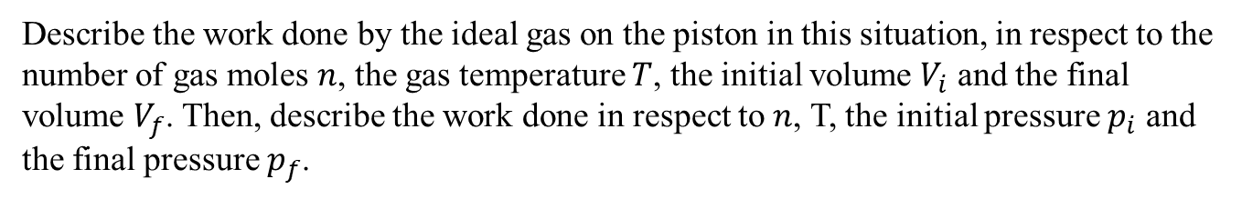

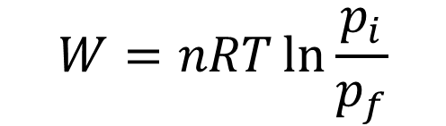
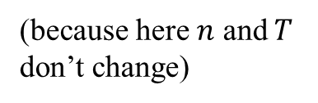
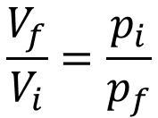
Ex: Work done on a piston by an ideal gas in isothermal expansion
Describe the work done by the ideal gas on the piston in this situation, in respect to the number of gas moles $n$, the gas temperature $T$, the initial volume $V_{i}$ and the final volume $V_{f}$. Then, describe the work done in respect to$n$, T, the initial pressure $p_{i}$ and the final pressure $p_{f}$.
$$W=\int_{V_{i}}^{V_{f}}{pdV }=\int_{V_{i}}^{V_{f}}{\frac{nRT }{V}dV }=nRT\int_{V_{i}}^{V_{f}}{\frac{\text{1} }{V}dV }$$
(because here $n$ and $T$ don’t change)
$$W=nRT{\left[\ln{V}\right]}_{V_{i}}^{V_{f}}=nRT\ln{V_{f}}−nRT\ln{V_{i}}=nRT\ln{\frac{V_{f}}{V_{i}}}$$
Ideal gas law:
$$pV=nRT=Cte$$
(because here $n$ and $T$ don’t change)
$$p_{i}V_{i}=p_{f}V_{f}$$
$$\frac{V_{f}}{V_{i}}=\frac{p_{i}}{p_{f}}$$
$$W=nRT\ln{\frac{p_{i}}{p_{f}}}$$

Slide 18
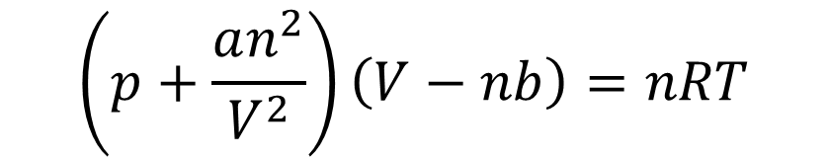
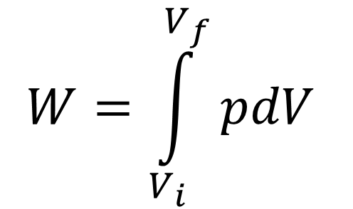
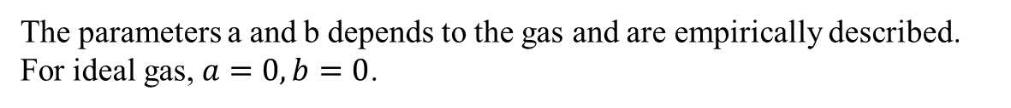
Comments
$$W=\int_{V_{i}}^{V_{f}}{pdV }$$
This expression is right for ideal gas and non-ideal gas (where the integral can be plus or less complicated to calculate)
For instance, here is the Van der Walls equation, which describe more accurately the relation between pressure, volume and temperature than the ideal gas law:
$$\left(p+\frac{an^{2}}{V^{2}}\right)\left(V−nb\right)=nRT$$
(you don’t need to remember, I give you for information)
The parameters a and b depends to the gas and are empirically described. For ideal gas, $a=0,b=0$.

Slide 19
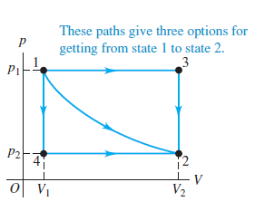
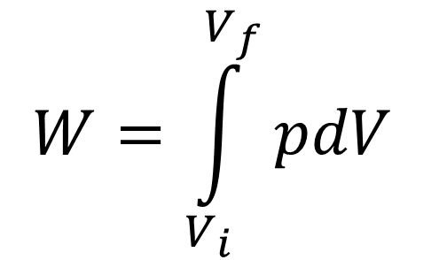

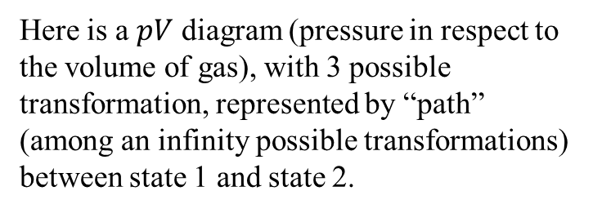
Discussion
$$W=\int_{V_{i}}^{V_{f}}{pdV }$$
The work done by the gas to the piston depends not only to the final state and initial state. It depends also to the transformation.
Here is a $pV$ diagram (pressure in respect to the volume of gas), with 3 possible transformation, represented by “path” (among an infinity possible transformations) between state 1 and state 2.
The work is described by the area under the curve chosen which depends to which path is chosen !
Area = work for the path $1→4→2$

Slide 20

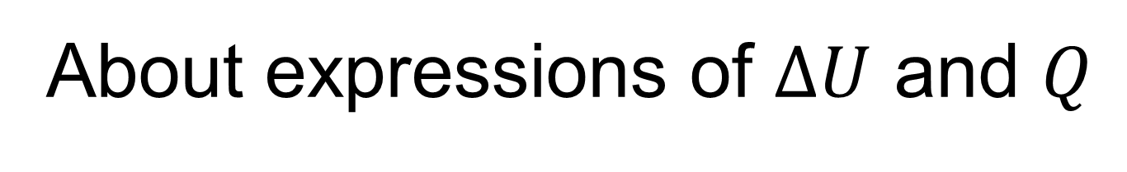
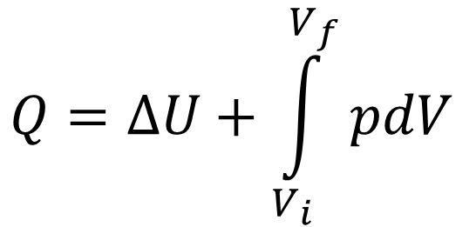

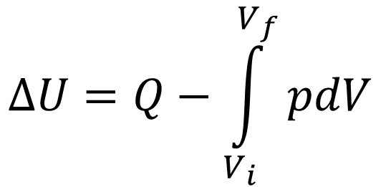
About expressions of $∆U$ and $Q$
$$∆U=Q−\int_{V_{i}}^{V_{f}}{pdV }$$
$$∆U=Q−W$$
Often, the work and the change of internal energy are easy to calculate, which permit to describe the heat:
$$Q=∆U+\int_{V_{i}}^{V_{f}}{pdV }$$
$$Q=∆U+W$$

Slide 21

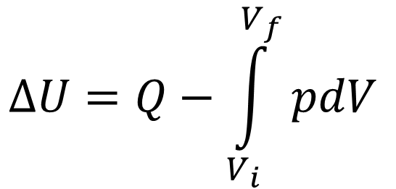
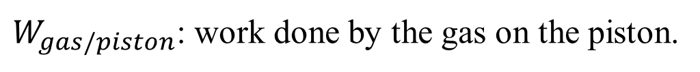
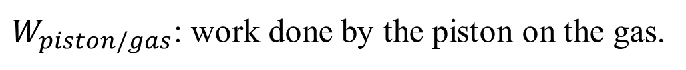

$$∆U=Q+W_{piston/gas}$$
Both are right, but it could be easy to confuse them and do a mistake …
$$∆U=Q−W_{gas/piston}$$
$W_{piston/gas}$: work done by the piston on the gas.
$W_{gas/piston}$: work done by the gas on the piston.
$$∆U=Q−\int_{V_{i}}^{V_{f}}{pdV }$$
But here, there is no possible confusion ! So this relation is important to remember.

Slide 22
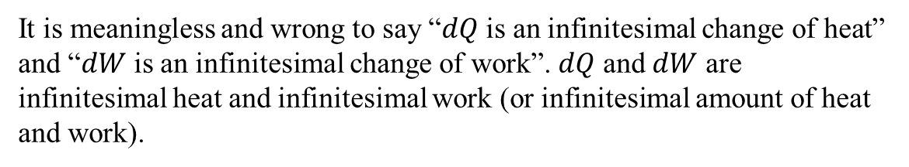


Infinitesimal change of internal energy and infinitesimal heat
$$∆U=Q−W$$
During a process of internal energy change, the infinitesimal change of internal energy $dU$ is:
$$dU=dQ−dW=dQ−pdV$$
The infinitesimal heat transfer $dQ$ is then:
$$dQ=dU+dW=dU+pdV$$
It is meaningless and wrong to say “$dQ$ is an infinitesimal change of heat” and “$dW$ is an infinitesimal change of work”. $dQ$ and $dW$ are infinitesimal heat and infinitesimal work (or infinitesimal amount of heat and work).
!

Slide 23
2.Heat capacities of an ideal gas

Slide 24
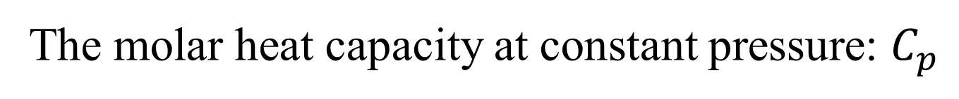
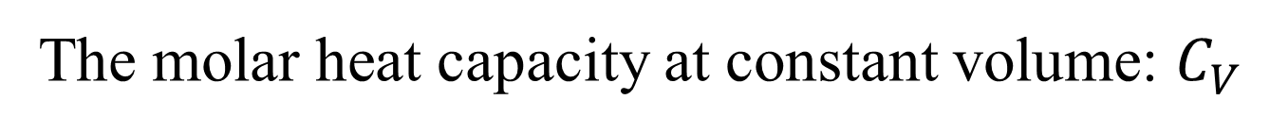
Heat capacities of an ideal gas
There is two important parameters of an ideal gas (which depends to the gas considered)
The molar heat capacity at constant volume: $C_{V}$
The molar heat capacity at constant pressure: $C_{p}$

Slide 25

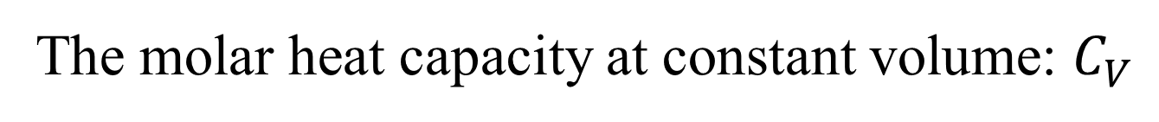
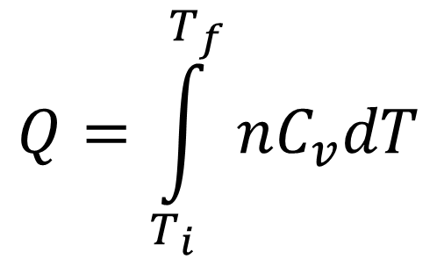
Heat capacities of an ideal gas
The molar heat capacity at constant volume: $C_{V}$
We consider a transformation where the volume is constant (for instance, using a rigid container where is the ideal gas). The infinitesimal heat transfer between the gas and its surrounding is then described by:
$$dQ=nC_{v}dT$$
where $n$ is the number of moles of gas, and $dT$is an infinitesimal change of temperature
The heat transfer between two states, an initial state at temperature $T_{i}$ and a final state at temperature $T_{f}$, for a transformation at constant volume is:
$$Q=\int_{T_{i}}^{T_{f}}{nC_{v}dT}$$
Important to remember

Slide 26

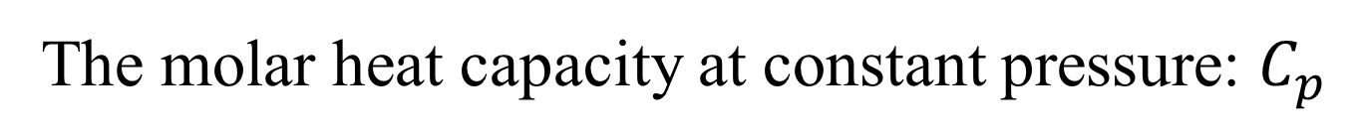
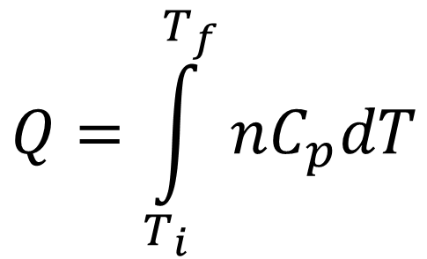
Heat capacities of an ideal gas
The molar heat capacity at constant pressure: $C_{p}$
We consider a transformation where the pressure is constant. The infinitesimal heat transfer between the gas and its surrounding is then described by:
$$dQ=nC_{p}dT$$
where $n$ is the number of moles of gas, and $dT$is an infinitesimal change of temperature
The heat transfer between two states, an initial state at temperature $T_{i}$ and a final state at temperature $T_{f}$, for a transformation at constant pressure is:
$$Q=\int_{T_{i}}^{T_{f}}{nC_{p}dT}$$
Important to remember

Slide 27
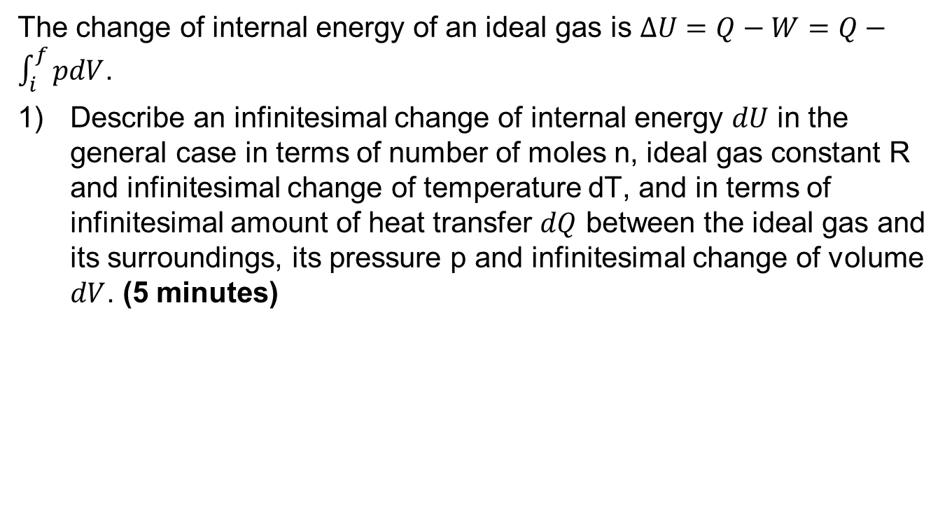
Exercise: Internal energy, heat capacities and ideal gas constant
The change of internal energy of an ideal gas is $ΔU=Q−W=Q−\int_{i}^{f}{pdV}$.
Describe an infinitesimal change of internal energy $dU$ in the general case in terms of number of moles n, ideal gas constant R and infinitesimal change of temperature dT, and in terms of infinitesimal amount of heat transfer $dQ$ between the ideal gas and its surroundings, its pressure p and infinitesimal change of volume $dV$. (5 minutes)

Slide 28
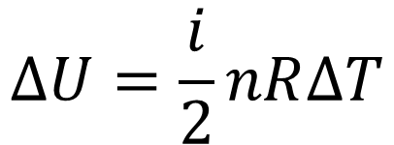
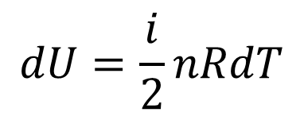
Exercise: Internal energy, heat capacities and ideal gas constant
We have described the internal energy change when its temperature change as follows ($i$ is the degree of freedom of the gas):
$$∆U=\frac{i}{2}nR∆T$$
Considering a gas with constant n, the infinitesimal change of internal energy is:
$$dU=\frac{i}{2}nRdT$$
And
$$dU=dQ−dW=dQ−pdV$$

Slide 29



Exercise: Internal energy, heat capacities and ideal gas constant
The change of internal energy of an ideal gas is $ΔU=Q−W=Q−\int_{i}^{f}{pdV}$.
(2) Considering an isochoric process (transformation at constant volume), describe the molar heat capacity at constant volume $C_{v}$ in terms of R and $i$ the number of degrees of freedom of the ideal gas. Deduce an expression of change of internal energy in terms of $n$, $C_{v}$,and change of temperature $ΔT$ (5 minutes)
$$dU=\frac{i}{2}nRdT$$
$$dU=dQ−pdV$$

Slide 30


Exercise: Internal energy, heat capacities and ideal gas constant
We have described the internal energy change when its temperature change as follows ($i$ is the degree of freedom of the gas):
$$∆U=\frac{i}{2}nR∆T$$
Considering a gas with constant n, the infinitesimal change of internal energy is:
$$dU=\frac{i}{2}nRdT$$
And
$$dU=dQ−dW=dQ−pdV$$
For a transformation at constant volume,
$$dW=pdV=0$$
$$dU=dQ=nC_{v}dT$$

Slide 31



Exercise: Internal energy, heat capacities and ideal gas constant
$$dU=\frac{i}{2}nRdT$$
For a transformation at constant volume,
$$dU=dQ=nC_{v}dT$$
$$C_{v}=\frac{i}{2}R$$
We obtain:
i: number of degree of freedom of the ideal gas
R: Ideal gas constant

Slide 32





Exercise: Internal energy, heat capacities and ideal gas constant
Examples:
$$C_{v}=\frac{3}{2}R$$
$$C_{v}=\frac{5}{2}R$$
Mono-atomic gas ($i=3$ degrees of freedom)
Diatomic gas ($i=5$ degrees of freedom, vibrational motion not considered, translational and rotational motion considered)
Warning: Take care that the number of degrees of freedom of arbitrary gas molecules depends to the temperature. Usually we consider a process in a range of temperature such as the number of degrees of freedom is constant, thus $C_{v}$ is constant.

Slide 33






Exercise: Internal energy, heat capacities and ideal gas constant
$$U=\frac{i}{2}nRT$$
$$C_{v}=\frac{i}{2}R$$
The internal energy can be expressed as follows:
$$U=nC_{v}T$$
$$dU=nC_{v}dT$$
The change of internal energy due to a change of temperature is (if number of moles of gas $n$ constant):
$$∆U=nC_{v}∆T$$
Important to remember
Warning: this expression is right for any transformation, at constant volume but also if the volume change

Slide 34





Internal energy, heat capacities and ideal gas constant
Now, we consider a transformation at constant pressure $p$, then:
$$dQ=nC_{p}dT$$
The infinitesimal change of internal energy is:
$$dU=dQ−dW=nC_{p}dT−pdV$$
Considering an ideal gas:
$$V=\frac{nRT}{p}$$
d$V=\frac{nRdT}{p}$
$$pV=nRT$$
(because n and p are constant)
During a transformation at constant pressure (p constant), for a closed system (n constant)
$$dW=pdV=nRdT$$

Slide 35








Internal energy, heat capacities and ideal gas constant
Now, we consider a transformation at constant pressure $p$, then:
$$dQ=nC_{p}dT$$
The infinitesimal change of internal energy is:
$$dU=dQ−dW=nC_{p}dT−pdV$$
Considering an ideal gas:
$$V=\frac{nRT}{p}$$
d$V=\frac{nRdT}{p}$
$$pV=nRT$$
(because n and p are constant)
$$pdV=nRdT$$
$$dU=dQ−pdV=nC_{p}dT−nRdT=n\left(C_{p}−R\right)dT$$
$$dU=n\left(C_{p}−R\right)dT$$
$$dU=nC_{v}dT$$
$$C_{p}−R=C_{v}$$

Slide 36








Internal energy, heat capacities and ideal gas constant
$$C_{p}=C_{v}+R$$
Expression (important to remember) of the molar heat capacity at constant pressure. Because $C_{v}$ depends to the degree of freedom, $C_{p}$ depends also to the degree of freedom.
Examples:
$$C_{v}=\frac{3}{2}R$$
$$C_{v}=\frac{5}{2}R$$
$$C_{p}=\frac{5}{2}R$$
$$C_{p}=\frac{7}{2}R$$
Mono-atomic gas ($i=3$ degrees of freedom)
Diatomic gas ($i=5$ degrees of freedom, if no vibrational motion)

Slide 37






Infinitesimal heat for a transformation where the pressure and volume change ?
For a transformation at constant volume
$$dQ=nC_{v}dT$$
For a transformation at constant pressure
$$dQ=nC_{p}dT$$
For any other transformation:
$$dQ=nCdT$$
where $C$ is the molar heat capacity, take care that it depends on the temperature, you can’t put it outside the following integral
$$Q=\int_{T_{i}}^{T_{2}}{nCdT }$$
An easy way to calculate the heat during a process where the volume and the pressure change is to use:
$$dQ=dU+pdV$$

Slide 38






Summary: results to remember
$$dU=dQ−dW=dQ−pdV$$
For any transformation
$$dU=nC_{v}dT$$
For any transformation
$$dQ=nC_{v}dT$$
For a transformation at constant volume
$$dQ=nC_{p}dT$$
For a transformation at constant pressure
$$dQ=dU+pdV$$
For any transformation
$$C_{v}=\frac{i}{2}R$$
$$C_{p}=C_{v}+R$$
You don’t need to remember the demonstrations. Remember the results obtained is sufficient. But it is much better if you understand the demonstrations !

Slide 39
End of lecture 3, heat transfers

